Slide 1
eVal Implementation
EVALUATOR EXPERIENCE
May 27, 2015

Slide 2
Home
Log Out
eVal for Evaluating Teachers
eVal for improving observation skills (Practice Sessions, Learning Walk-through,, Alerts
eVal for evaluating Principals
My eVal Account
For setting up for mobile app; could also have Help info for OSPI portal and, if you are principal, reminder of eVal roles of HP, Building Admin
Welcome Doris Day
District: Seattle Public Schools
School: Daniel Boone Elementary
eVal Role: Head Principal; Building Administrator

Slide 3


Home/ Eval for Evaluating Teachers
Daily Workbench
Summative Tasks
Alerts
Reports
Help
2014-2015
Log Out
❍ All teachers
Workbench Dashboard
Workbench Overview
❍ Assigned teachers
 | ASSIGNMENTS |  |  | EVIDENCE |  |  |  |  |  |  | WORKFLOW
 |  |  |  | Artifacts |  | Observations |  |  |  | Other
 |  |  |  | New | Re-viewed
Teacher | Eval Cycle | Evauator | Area of Focus | 2 | 3 | START NEW | D1 | D2 | D3 | Ad-hoc or non-observeable | Self Assessment | Goals | Summative Status
Daisy Miller | C | P1 |  | 1 | 0 | ■ | 10/14/14 3/1/15 |  | 12/15/15 |  | 1 | 1 | Draft
George Elliot | F | P1 | C1, SG-C3 | 0 | 2 | ■ |  | 10/3/14, 3/12/15 |  | ✓ | 1 | 1 | Ready for teacher conference
Tess D’ubervilles | C | P1 |  | 2 | 3 | ■ | 11/15/15 |  |  |  |  | 1 | Draft
Elizabeth Bennett | F | P1 | C4, SG-C3 | 1 | 2 | ■ |  | 11/31/14, 2/23/15 |  | ✓ | 1 | 2 | Draft
Sarah Crewe | C | P1 |  | 1 | 1 | ■ | 11/15/14 | 2/1/15 | 3/1/15 | ✓ |  | 1 | Draft
Click on a teacher to get started…
Do we have indicator that an observation is not yet visible to the teacher? Or, make an alert if observation is over X days old and still not visible to the teacher, esp if observation is past its scheduled date????

Slide 4
Home/ Eval for Evaluating Teachers
Daily Workbench
Summative Tasks
Alerts
Reports
Help
2014-2015
Log Out
Workbench Dashboard
Workbench Overview
Text or flow chart providing overview of this section – including how it differs from what the teacher sees or can do.

Slide 5
Home/ Eval for Evaluating Teachers
Daily Workbench
Summative Tasks
Alerts
Reports
2014-2015
Help
Log Out
George Elliot
Claim Statements
Uploaded Items
Observations
Alerts
C1
Centering instruction on high expectations for student achievement.
Evidence Dashboard
Details
2b. Establish a culture for learning
The classroom culture is a cognitively busy place where learning is valued by all, with high expectations for learning being the norm for most students.
Kindergarten lesson plan
Playground photo
2014-2015.1 2014-2015.2
View Rubric
Add New
Review Artifacts
3a: Communicating with Students
The teacher clearly communicates instructional purpose of the lesson, including where it is situated within broader learning, and explains procedures and directions clearly.
Spanish lesson plan
AP group activity
2014-2015.2 2014-2015.3
Observations
3c: Engaging students in learning
Students may have some choice in how they complete tasks and may serve as Alerts for one another.
Student video
3rd grade Wiki
2014-2015.4 2014-2015.5

Slide 6
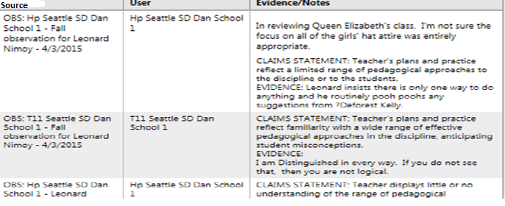
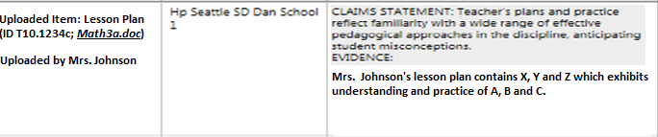
Home/ Eval for Evaluating Teachers
2014-2015
Daily Workbench
Summative Tasks
Alerts
Reports
Help
Log Out
George Elliot
ADD NEW
Alerts
Evidence Dashboard
Details
View Rubric
Add New
Review Artifacts
Observations
Legend:
During Observation
Outside of observation
Uploaded Item
Evaluator

Slide 7
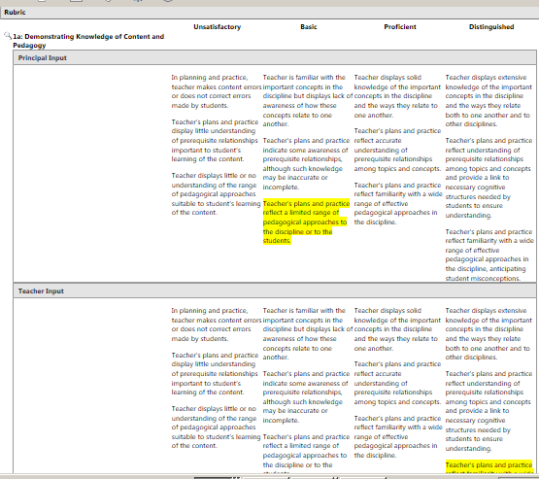
Home/ Eval for Evaluating Teachers
2014-2015
Daily Workbench
Summative Tasks
Alerts
Reports
Help
Log Out
George Elliot
ADD NEW
Alerts
Evidence Dashboard
Details
View Rubric
Add New
Review Artifacts
Observations

Slide 8
Home/ Eval for Evaluating Teachers
2014-2015
Daily Workbench
Summative Tasks
Alerts
Reports
Help
Log Out
George Elliot
User has option to upload an artifact or enter claim statement/evidence.
User has option to attach an existing artifact to the evidence/ claim statement
User has option to assign the artifact to an existing observation
Alerts
Evidence Dashboard
Details
View Rubric
Add New
Review Artifacts
Observations
Tip for supporting your teachers:
When coaching teachers on this tool, keep in mind that they do not have this screen. They can only add evidence directly to an observation or by loading an artifact.

Slide 9
Home/ Eval for Evaluating Teachers
2014-2015
Daily Workbench
Summative Tasks
Alerts
Reports
Help
Log Out
George Elliot
Alerts
Evaluator needs way to see what is in the queue waiting for review, plus all artifacts uploaded by the teacher, and artifacts uploaded by the evaluator, plus edit their own or add new.
Evaluator should also have opportunity to mark the artifact as officially “reviewed” so that when they look at the list later, they know it has been completed and also the teacher will know. If the evaluator doesn’t mark it “reviewed” but adds evid or claim statement, then it is considered “reviiewed”
Evidence Dashboard
Review Artifacts
Observations
Tip for supporting your teachers:
As an evaluator, your menu reads “Review Artifacts.” The teachers screen will read “Manage Artifacts.”

Slide 10
Home/ Eval for Evaluating Teachers
2014-2015
Daily Workbench
Summative Tasks
Alerts
Reports
Help
Log Out
George Elliot
OVERVIEW OF “OBSERVATIONS “ IN EVAL
eVal allows you to prepare for and respond to each phase of the observation process (depending on your District, you may or may not use all of the functionality).
As you and the teacher add information into an observation, it immediately becomes available for viewing on the Observation tab and on the Observation Report.
When the observation activities are complete, you may lock the observation. This indicates that you have both entered any evidence and comments you wish to add and that you are now considering the Report as “final.” If either of you wish to unlock the observation, you may send each a request to do so. Locking the observation ensures that the information provided to the teacher on the Observation Report cannot be changed without both you and the teacher agreeing to it.
Information from a locked observation will now be available as selectable content on the teacher’s Summative Evaluation.
(You may enter evidence that is not related to an observation directly into the Evidence Dashboard)
Alerts
Evidence Dashboard
Review Artifacts
Observations
Overview
Add New
Formal
10/1/14
12/15/14
2/20/15
Walk-through
10/15/14
12/31/14
1/20/15
3/14/15
Practice

Slide 11
Home/ Eval for Evaluating Teachers
2014-2015
Daily Workbench
Summative Tasks
Alerts
Reports
Help
Log Out
George Elliot
Alerts
THIS IS WHERE EVALUATOR SETS EVERYTHING UP – THE PRE CONF, POST CONF AND THE SESSION. INCLUDING DATES, AREA OF FOCUS, ETC.
Form asks if formal or walk-thru, whether there is a pre-conf, if so, whether if the observation will be focused or not on a particular area, plus add any prompts; whether there is post conf, if so, prompts for that too. (Could be sep tabs).
Usually, it is the evaluator who selects whether there is to be a pre-conf and post-conf, so if they don’t choose one, there usually won’t be one – except, the teacher can always request a post conf – I think even for a walk-thru, need to check CBA
This form is used only for seting it up. After it is set up, it will appear on the left nav menu
Evidence Dashboard
Review Artifacts
Observations
Overview
Add New
Formal
10/1/14
12/15/14
2/20/15
Walk-through
10/15/14
12/31/14
1/20/15
3/14/15
Tip for supporting your teachers:
The teacher ‘s menu for Observations is almost identical to yours – but they do not have the “Add New” menu item.
Practice

Slide 12
Home/ Eval for Evaluating Teachers
2014-2015
Daily Workbench
Summative Tasks
Alerts
Reports
Help
Log Out
George Elliot
(Drop down box)
Alerts
Observation Workflow
Evidence Dashboard
General Info
Review Artifacts
Oops – there also needs to be ability to edit here.
Observations
Overview
Add New
Observation Focus (if there is one):
Pre-Conf Date:
Observation Date:
Post Conf Date:
Has Observation been locked?
(To lock or respond to unlock request, user will go to the Lock tab)
Formal
10/1/14
12/15/14
2/20/15
Walk-through
10/15/14
12/31/14
1/20/15
3/14/15
Each observation screen needs indicator of: 1. If locked or 2. if submitted (because either case, no further changes allowed) this is for both teacher and evaluator.
Practice

Slide 13
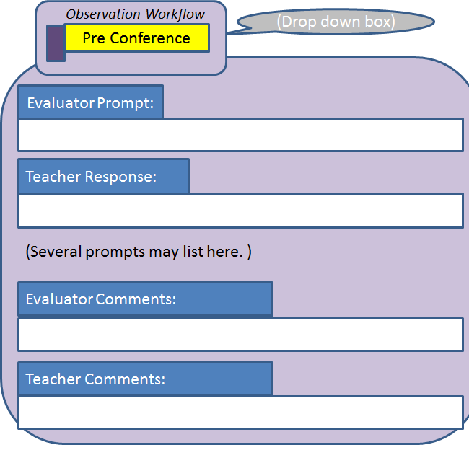
Home/ Eval for Evaluating Teachers
2014-2015
Daily Workbench
Summative Tasks
Alerts
Reports
Help
Log Out
George Elliot
Alerts
Evidence Dashboard
Review Artifacts
Observations
Overview
Add New
Formal
10/1/14
12/15/14
2/20/15
Walk-through
10/15/14
12/31/14
1/20/15
3/14/15
Practice

Slide 14
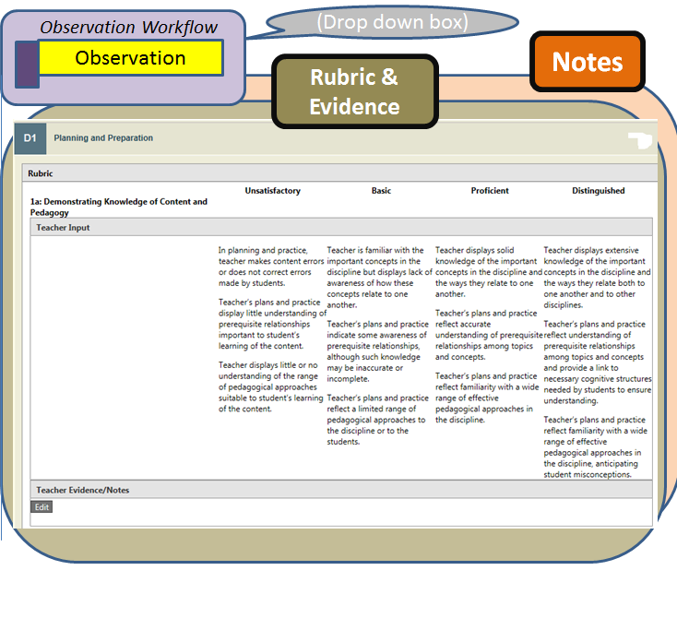
Home/ Eval for Evaluating Teachers
2014-2015
Daily Workbench
Summative Tasks
Alerts
Reports
Help
Log Out
George Elliot
Alerts
Evidence Dashboard
Review Artifacts
Observations
Overview
Add New
Formal
10/1/14
12/15/14
2/20/15
Walk-through
10/15/14
12/31/14
1/20/15
3/14/15
Practice

Slide 15
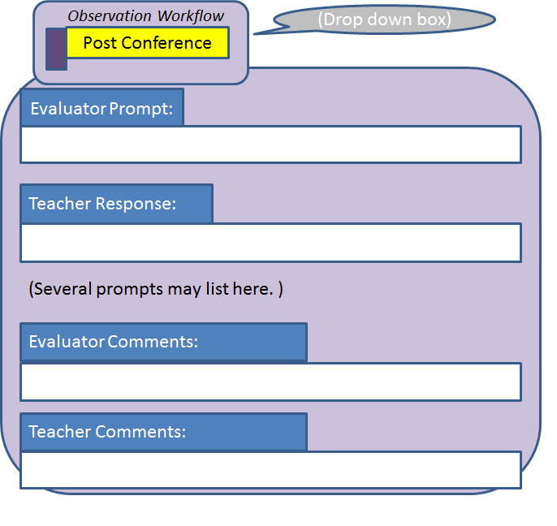
Home/ Eval for Evaluating Teachers
2014-2015
Daily Workbench
Summative Tasks
Alerts
Reports
Help
Log Out
George Elliot
Alerts
Evidence Dashboard
Review Artifacts
Observations
Overview
Add New
Formal
10/1/14
12/15/14
2/20/15
Walk-through
10/15/14
12/31/14
1/20/15
3/14/15

Slide 16
Home/ Eval for Evaluating Teachers
2014-2015
Daily Workbench
Summative Tasks
Alerts
Reports
Help
Log Out
George Elliot
Alerts
Observation Workflow
(Drop down box)
Evidence Dashboard
Lock/ Unlock
Review Artifacts
Observations
Overview
Add New
Formal
10/1/14
12/15/14
2/20/15
Walk-through
10/15/14
Tip for supporting your teachers:
Make your input visible to the teacher as quickly as possible so they have ample time to review it, confer further with you and add their own evidence and claim statements.
12/31/14
1/20/15
3/14/15

Slide 17
Daily Workbench
Summative Tasks
Alerts
Reports
2014-2015
Help
Log Out
Observation Workflow
(Drop down box)
George Elliot
Report
Alerts
Evidence Dashboard
Review Artifacts
Observation report prints to this screen; user has option to download as PDF
Observations
Overview
Add New
Formal
10/1/14
12/15/14
2/20/15
Walk-through
Tip for supporting your teachers:
The teacher doesn’t have to wait until you have locked the report. As soon as you make the observation visible, all of the information either of you enter will be available to them in this report.
10/15/14
12/31/14
1/20/15
3/14/15

Slide 18
Daily Workbench
Summative Tasks
Alerts
Reports
2014-2015
Help
Log Out
Observation Workflow
(Drop down box)
Teacher Response
George Elliot
Alerts
Text appears here explaining that the teacher may elect to add final comments that will appear on the report.
Evidence Dashboard
Review Artifacts
Observations
Teacher’s Response
Overview
Add New
Formal
10/1/14
12/15/14
2/20/15
Walk-through
10/15/14
Tip for supporting your teachers:
If a teacher disagrees with your input, encourage them to add their own evidence and claim statements directly into the rubric before the report is locked.
12/31/14
1/20/15
3/14/15

Slide 19
Daily Workbench
Summative Tasks
Alerts
Reports
2014-2015
Help
Log Out
George Elliot
Notifications are listed here of any new activity related to evidence or observations.
Will include –
New artifact loaded by teacher
Teacher added evidence or claim statement or comments to Existing artifact or Observation
Teacher added prompt response or comments to Pre Conf or Post Conf
Teacher added Teacher Response to Observation Report (after it has been locked)
Teacher has requested for an observation to be unlocked
More than X days have passed since the observation was created and the evaluator still has not made it visible to the teacher.
Alerts
Evidence Dashboard
Review Artifacts
Observations
Overview
Add New
Formal
10/1/14
12/15/14
2/20/15
Walk-through
10/15/14
12/31/14
1/20/15
3/14/15

Slide 20
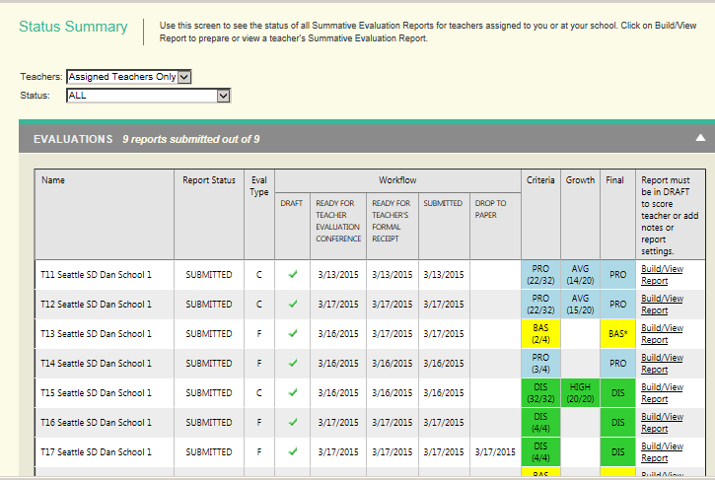
Daily Workbench
Summative Tasks
Alerts
Reports
2014-2015
Help
Log Out
Summative Dashboard
Summative Overview
Click on a teacher to get started..
We can remove this last column and instead make the teacher’s name the hyperlink, yes?

Slide 21
Daily Workbench
Summative Tasks
Alerts
Reports
2014-2015
Help
Log Out
Summative Dashboard
Summative Overview
Here will be text with high level overview of the process within eVal, along with a few “Tips for Supporting your teacher” such as encouraging teacher to input Reflections, etc.
Tips for evaluator will include making sure observations are concluded and locked, that they have conferred with the teacher on next year’s evaluation cycle and area of focus, that they have conferred with the teacher on any particular observations that the teacher would like included, etc.

Slide 22
Daily Workbench
Summative Tasks
Alerts
Reports
2014-2015
Help
Log Out
George Elliot
Summative Alerts
These menu items would mimic existing panels.
Summative Workflow
Teacher’s Reflections
Summative Scoring & Statements
Build Report
View Report
Teacher’s Response
Tip for supporting your teachers:
The teacher’s Summative Information is under their “Workflow” menu. (The teacher does not have a “Summative Tasks” menu item)

Slide 23
Daily Workbench
Summative Tasks
Alerts
Reports
2014-2015
Help
Log Out
George Elliot
Summative Alerts
Notices would appear here if:
Teacher adds Reflection
Teacher adds Teacher Response (after report is finalized and they are acknowledging it)
Or, teacher never adds teacher response and the timer expires so the report auto-submits
Report has been in “Ready for teacher conf” for more than X days
Report has been in “Waiting for teacher acknowledgement” for more than X days
Summative Workflow
Teacher’s Reflections
Summative Scoring & Statements
Build Report
View Report
Teacher’s Response

Slide 24
Daily Workbench
Summative Tasks
Alerts
Reports
2014-2015
Help
Log Out
Select | Date | Source | Activity | See Change
□ | 11/1/15 | Mary Poppins | Pre-Conf prompt answered | 2013-2014.1/pre-conf
□ | 11/1/15 | George Elliot | Post conf comment | 2013-2014.1/ pre conf
□ | 11/15/15 | Sarah Crew | Artifact C234 has loaded | Artifact C234
□ | 11/30/15 | Mary Poppins | Evidence added to Artifact D111 | Artifact D111
□ | 12/15/15 | Sarah Crew | Teacher requests unlock | 2013-2014.1
□ | 5/15/15 | Sarah Crew | Final Reflections updated | Summative Eval
□ | 12/15/15 | Mary Poppins | Teacher Response added to observation | 2013-2014.1/Response
□ | 5/15/15 | Mary Poppins | Teacher received Summative Evaluation | Summative Eval
□ | 1/5/15 | eVal Team | Updates added to eVal. | Release Notes
Controls to sort and filter the list and to clear selected rows.

Slide 25
Daily Workbench
Summative Tasks
Alerts
Reports
2014-2015
Help
Log Out
(Include note that the Observation report is in the Observation workflow under Daily Workbench and the Summative Evaluation is under Summative Tasks)

Slide 26
Daily Workbench
Summative Tasks
Alerts
Reports
2014-2015
Help
Log Out
eVal User Guides
Support
This part still needs to be designed. User guide and Help can be District-specific (and Districts could elect to turn off the State-supplied ones). Evaluator would have access to both the evaluator and the teacher user guides. Help would include District’s support email.
Release Notes (what’s new in eVal)

